Slide 1

Start
Chapter 3
Learning and theories of learning
3.1 Definition of Learning
Learning is a relatively permanent change in behavior, occurring as the result of practice or experience.
The above definition emphasizes 3 attributes of learning:
Learning is a change in behavior. This change in behavior is relatively permanent.
Learning does not include change due to illness, fatigue, growth, maturation and use of intoxicant ( biological factors in general) but change due to experience or practice.

Slide 2
Con’d
The learning is not directly observable but manifests in the activities of the individual.
3.2 The Major characteristics of learning
1. Lg is continuous modification of behavior throughout life.
2. Lg is pervasive, it reaches into all aspects of human life.
3.Lg involves the whole person, socially, emotionally & intellectually.
4. Learning is often a change in the organization of experiences.
5. Learning is responsive to incentives.
6. Learning is an active process.

Slide 3
Con’d
7. Learning is purposeful. i.e. it doesn’t occurs haphazardly.
8. Learning depends on maturation, motivation and practice.
9. Learning is multifaceted- having many different sides or aspects

Slide 4
Con’d
3.3 Principle of learning: principles that help explaining how learning occurs.
Individuals learn best when they are physically, mentally, and emotionally ready to learn.
Students learn best and retain information longer when they have meaningful practice and exercise.
learning is weakened when associated with an unpleasant feeling.
Things learned first create a strong impression in the mind.

Slide 5
Con’d
Things most recently learned are best remembered.
The principle of intensity implies that a student will learn more from the real thing than from a substitute.
Individuals must have some abilities and skills that may help them to learn.
Things freely learned are best learned.

Slide 6
Con’d
3.4 Methods or Ways of Learning
1.Trial and error or experimental learning- the person learns personally without a teacher or a tutor.
2.Observation or imitation- the person learns by observing others. There is no a direct teacher but there is a model person to be imitated.
3.Instruction, training, and advice- the person can learn directly from instructor, teacher, trainer or tutor.

Slide 7
Con’d
3.5 Factors Influencing Learning
Motivation or Arousal: the learner‘s motivation matters the effectiveness of learning.
Maturation: Neuro-muscular coordination is important for learning a given task.
Health condition of the learner-Sensory defects, malnutrition, toxic conditions of the body, loss of sleep and fatigue hinder effective learning.
Psychological wellbeing of the learner: individual‘s psychological states like worries, fears, feelings of loneliness and inferiority hinders learning.

Slide 8
Con’d
Good working conditions- absence of fresh air, light, comfortable surroundings, moderate temperature, distractions like noise etc.
Background experiences: having background experiences affect effectiveness of learning.
Length of the working period: Learning periods should neither be too short nor too long.
Massed and distributed learning: Learning that spreads across time with reasonable time gaps brings better results compared with crammed learning.

Slide 9
Con’d
Reinforcement: For a behavior to be repeated it has to be reinforced.
Performance of activity with reputation: reputation is effective to bring desired change when it is made intermittently or with break
3.6 Learning Outcomes/Forms of Learning
The three domains of learning (Bloom, et al., 1956):
1.The Cognitive domain is focused on intellectual skills such as critical thinking, problem solving, and creating a knowledge base.
The cognitive domain encompasses of six categories which include knowledge; comprehension; application; analysis; synthesis; and evaluation

Slide 10
con’d
2.Affective domain involves our feelings, emotions, and attitudes of the individual.
This domain includes the manner in which we deal with things emotionally, such as feelings, values, appreciation, enthusiasms, motivations, and attitudes.
This domain include Receiving responding , valuing, organization and characterization (Anderson et al, 2011).
3.Psychomotor domain: manual or physical skills or skill learning.
The psychomotor domain includes physical movement, coordination, and use of the motor-skill areas.
Development of these skills requires practice and is measured in terms of speed, precision, distance, procedures, or techniques in execution.
The sub domains of psychomotor include perception, set, guided response, mechanism, complex overt response, adaptation and origination.

Slide 11
Con’d
Theories of Learning
A number of approaches of learning have been proposed with their possible implications and applications. Two major classifications are:
Simple Learning/Behavioral Theory of Learning - has 2 types
Coplex Learning/Cognitive Theories of Learning-has 3 types
1. Simple Learning/Behavioral Theory of Learning
Behaviorism is a school of thought that emphasizes the role of experience in directing or governing behavior.
They are interested only in behaviors that can be seen, measured and recorded. They argued that the environment determine behavior.
There are two major behavioral theories of learning. They are:
Classical conditioning 2. Operant conditioning.

Slide 12
Con’d
Pavlov’s Classical Conditioning Theory of Learning–Learning by Association
Ivan Petrovich Pavlov- a Russian physiologist and pioneer of classical conditioning.
Pavlov’s associative learning is called classical conditioning, or Pavlovian conditioning, type S-R learning, or substitution learning (because it involves substituting a neutral stimulus in place of natural stimulus.
The theory of classical conditioning represents a process in which a neutral stimulus is paired with a natural stimulus, which later acquires all the characteristics of natural stimulus.
A stimulus is anything that causes a response.

Slide 13
Con’d
Classical conditioning involves what are known as conditioned reflexes.
An example of this is a-knee-jerk reflex, blinking, sneezing etc
These reflexes are not controlled by the brain, but controlled by the spinal cord.
Another example of a reflex is the production of saliva in a response to food when we are hungry, and it was this response which Pavlov first investigated when he discovered classical conditioning.
Therefore classical conditioning is a type of learning in which a neutral stimulus comes to bring about a response after it is paired with a stimulus that naturally brings about that response.

Slide 14
Con’d
For Pavlov, learning is a function of association or repeated connection between two elements-stimulus-response (S-R).
e.g. If you frequently go to cafe with your friend, going to café alone ( without your friend), may help you to remember your friend.
Pavlov made his experiment on dog.
Pavlov experiment on dog has three elements:
1. Food 2. Salivation 3. Sound of a bell=previously Neutral stimulus Natural stimulus

Slide 15
con’d
Pavlov’s Experiments
At the beginning of the experiment, Pavlove sounded the bell and then quickly fed the dog, after he repeated this several times, the dog began to salivate after hearing the sound of the bell alone or with out meat /food.
Now the sound of a bell had become a conditioned stimulus (CS) -Stimulus that evokes emotional or physiological response after conditioning.

Slide 16
Con’d
The response of salivation after bell sound is called conditioned response (CR), which is a learned response, to a previously neutral stimulus.
Classical conditioning is a form of learning when previous neutral (CS) is associated with natural stimulus (UCS) to bring unlearned response (UCR) which involve involuntary response to stimuli.
Procedures of the Conditioning
Figure: Sequences of learning in classical conditioning

Slide 17
Con’d
Diagramming Classical Conditioning
In classical conditioning, a neutral stimulus (the tone or bell) is paired with an unconditioned stimulus (food) that normally elicits an unconditioned response (salivation).
With repeated pairings, the neutral stimulus becomes a conditioned stimulus that elicits the conditioned response of salivation.

Slide 18
Con’d
1. UCS (Unconditioned Stimulus) produces UCR (Unconditioned Response)
Food /meat Saliva
2. NS (Neutral Stimulus) produces No response
Ringing of bell No response
3. NS+UCS (Neutral + Unconditioned Stimulus) produces UCR (Uned Response)
Ringing of bell + (plus) food produce s Saliva
4. CS (Conditioned Stimulus) produce CR (Conditioned Re)
Ringing of bell alone Saliva
NS CS
UCS UCR

Slide 19
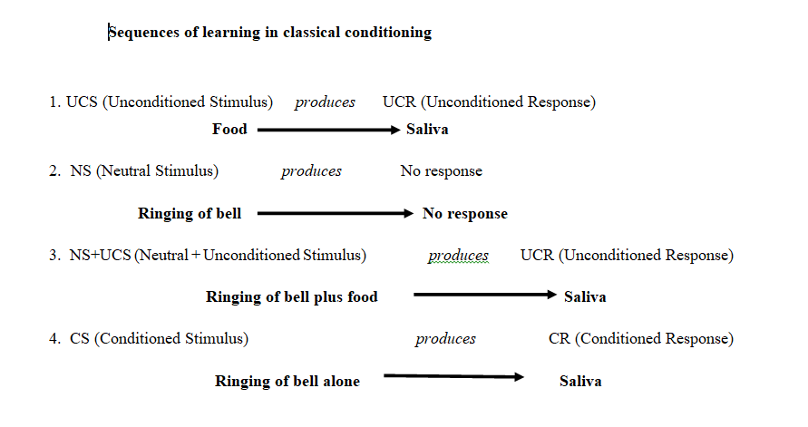
con’d

Slide 20
Con’d
Terminology of classical Conditioning
To demonstrate classical conditioning, we must first identify stimuli and responses.
Neutral stimulus (NS) is a stimulus that before conditioning does not produce a particular response. eg. sound of a bell
Unconditioned Stimulus (UCS) is the innate, natural stimulus that can elicits or produces a response without any prior learning.
e.g. Meat/food given to a dog.
UCS- is a stimulus that naturally brings about a particular response without having been learned.

Slide 21
con’d
Unconditioned Response (UCR) is a response that is elicited or produced by unconditioned stimulus.
When food is placed on a dog’s tongue, the dog naturally salivates. This reflexive behavior is called an unconditioned response (UCR) (unconditioned means “unlearned”).
e.g. Salivation due to food.
Conditioned stimulus (CS) is a previously neutral stimulus that comes to elicit/produce a conditioned response after it has been paired with an unconditioned stimulus.
e.g. The sound of a bell after repeated pairing of an UCS (food) had become now the conditioned (learned) stimulus.

Slide 22
Con’d
Conditioned Response (CR) is a learned or an acquired response to a conditioned stimulus.
A previously neutral stimulus (NS) becomes a conditioned stimulus (CS) when it is paired with an unconditioned stimulus (UCS) and begins to elicit the conditioned response.
e.g. the dog’s salivation in response to the sound of a bell is a conditioned response.
Features Classical Conditioning
1. Stimulus Generalization is a process in which a conditioned response to a stimulus is generalized to similar category of the stimuli. e .g a dog conditioned to salivate to a dinner bell (CS) might also salivate to a telephone bell.

Slide 23
Con’d
2. Acquisition - the acquisition phase is the initial learning of the conditioned response.
For example, the dog’s learning to salivate at the sound of the bell.
3. Extinction-refers to the gradual weakening and eventual disappearance of the conditioned response (CR) when the CS is repeatedly presented without the UCS.

Slide 24
Con’d
4. Stimulus Discrimination-refers to when the organism responds to certain stimuli but not others. it means that an organism learns to respond to a specific stimulus while not responding to other similar stimuli.
5. Spontaneous Recovery is the return of an extinguished response following a rest period.
The principle of spontaneous recovery explain that there is no complete extinction on the account of the time interval but there is inhibition of CR.

Slide 25
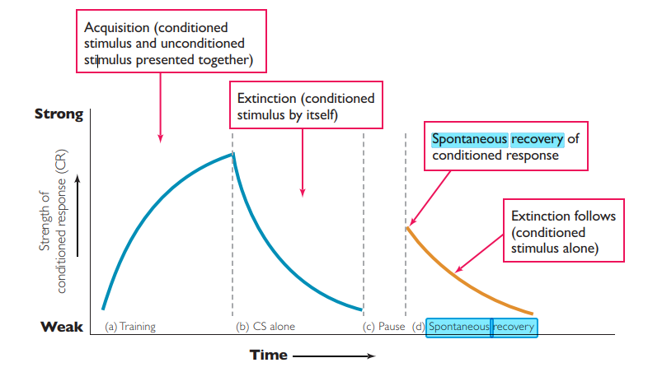
con’d

Slide 26
Con’d
Contribution of Pavlov’s theory
1.Removing maladaptive behavior such as smoking, bed wetting, fear, bad habits, hatred, stealing and the like.
2. Developing good habits and desirable behavior such as the habit of cleanliness, punctuality, respect for others, moral values and favorable attitudes etc.
3. Pavlov introduced how learning occurs through stimulus- response bondage (S-R association).

Slide 27
Con’d
2. Operant Conditioning (Learning from the Consequences of Our Behavior)
Burrhus Frederic Skinner (1904-1990) - American Psychologist and the founder of Operant Conditioning.
Operant conditioning also known as instrumental conditioning- is a process by which humans and animals learn to behave in such a way as to obtain rewards and avoid punishments.

Slide 28
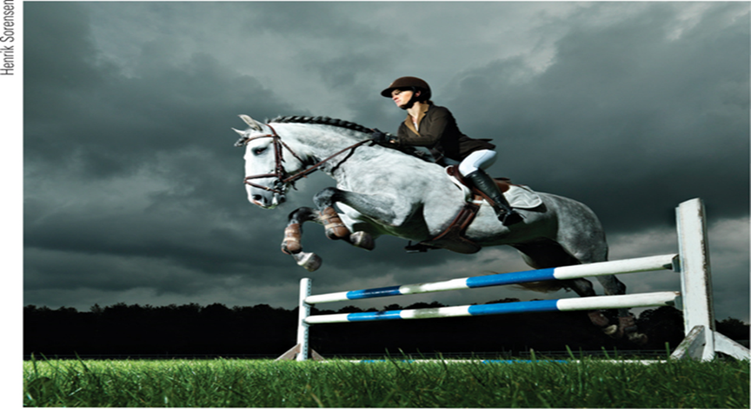
con’d

Slide 29
Con’d
Operant Conditioning is a form of learning in which the consequences of behavior produce changes in the probability that the behavior will occur.
In operant conditioning, organisms learn to associate a behaviour and its consequence.
A pleasant consequence makes that behaviour more likely to be repeated in the future.
Operant conditioning is a lg in which a voluntary response is strengthened or weakened, depending on its favorable or unfavorable consequences.
Through operant conditioning, an association is made between a behavior and a consequence (whether negative or positive) for that behavior.

Slide 30
Con’d
An emphasis on environmental consequences is at the heart of Operant conditioning (also called Instrumental Conditioning).
Unlike classical conditioning, operant conditioning applies to voluntary responses, which an organism performs deliberately to produce a desirable outcome.
Skinner proposed that organisms learn responses that operate on the environment to produce consequences, he therefore called this learning process operant conditioning.

Slide 31
con’d
Skinner attaches greater importance to operant behavior, which is primarily concerned with response rather than stimuli.
As a result, it is known as R-type conditioning vs S conditioning= R-S Vs S-R.
Skinner focuses on behavior that we should focus on the external causes of an action and the action‘s consequences.
The term operant emphasizes that the organism operates on its environment to produce a desirable result.

Slide 32
Con’d
In Skinner‘s analysis a response (operant) can lead to three types of consequences: a) a neutral consequence b) a reinforcement and c) punishment.
A neutral consequence that does not alter the response.
A reinforcement that strengthens the response or makes it more likely to recur.
Rt-any event that strengthens the behavior it follows.
Punishment-an event that tends to decrease the behavior that it follows.

Slide 33
Con’d
Operant- a Skinner Box-A special apparatus usually known as skinner’s box is used.
In operant conditioning experiment, a chamber (also known as a Skinner Box) containing a bar or key that an animal can manipulate to obtain a food or water reinforcer; attached devices record the animal’s rate of bar pressing or key pecking.
Skinner box is an experimental apparatus developed by B. F. Skinner for studying relationships between reinforcement and
behavior.

Slide 34
con’d
Principles of Operant conditioning
1.Reinforcement-refers to the process by which a stimulus or an event strengthens or increases the probability of an event that it follows.
Reinforcer is a stimulus or event that increases the probability that the response it follows will be repeated.
Adding a pleasant Stimulus to strength a behaviour.
Types of Reinforcement
i. Positive reinforcement- is any pleasant or desirable consequence that follows a response and increases the probability that the response will be repeated.
In positive reinforcement, a pleasant or desirable stimulus is added to increase a behavior.

Slide 35
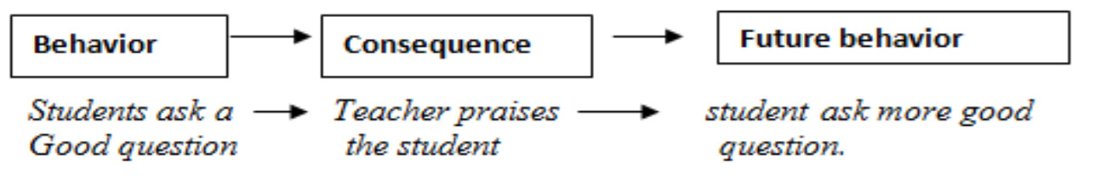
•A mother gives her son praise (reinforcing stimulus) for doing homework (behavior).

Slide 36
Con’d
Positive reinforcement strengthens a response by presenting something pleasant after the response.
Types of positive Rt
Reinforcers are rewards or incentives that guide behaviour in the direction so we get what we want.
1. Primary reinforcers are innately reinforcer stimulus, such as one that satisfies a biological need.
They are intrinsically rewarding because they satisfy basic biological needs or drives.
e.g. Food, water, light, sleep, oxygen, stroking of the skin, a comfortable air, temperature, relief from pain or loud noise etc.
Generally, they have the ability to strengthen a behavior without prior learning. i.e their reward or reinforcement value does not depend on learning.

Slide 37
Con’d
2.Secondary Reinforcers/Conditioned Reinforces/- are
learned reinforcers that develop their reinforcing properties because of their association with primary reinforcers.
They reinforce behavior because of their prior association with primary reinforcing stimuli.
Example- money, smiles, recognition, praise, applause, good grades, awards, and gold stars are common secondary reinforcers.
Both primary and secondary reinforcers can be positive or negative.

Slide 38
con’d
ii. Negative reinforcement is the process whereby termination or removed of an aversive (unpleasant, painful) stimulus makes behavior more likely to occur.
In negative reinforcement, a painful or unpleasant stimulus is removed.
Note: Negative reinforcement- the frequency of a behavior increases because it is followed by the removal of an aversive, (unpleasant) stimulus.
e.g Time-out is a popular form of negative punishment used by parents. The basic principle of negative Rt is that eliminating something aversive can itself be a reinforcer or a reward.

Slide 39
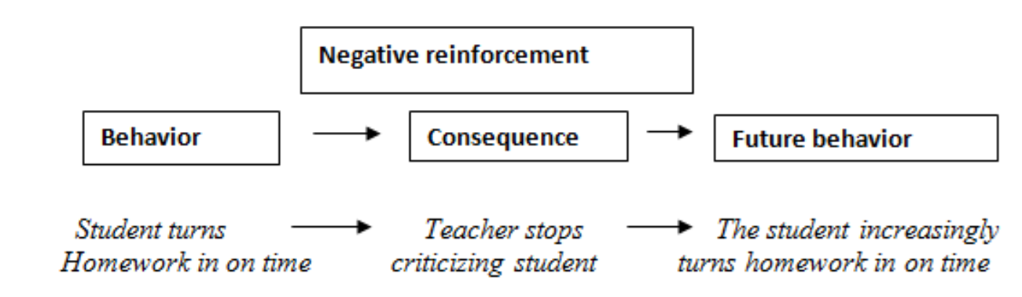
Con’d
For example, giving child praise for completing his homework represents positive reinforcement, whereas taking aspirin to reduce the pain of a headache represents negative reinforcement-something is given (positive reinforcement) or something is removed (negative reinforcement).
Abebe clean the dishes (behavior) in order to stop his mother’s nagging (aversive stimulus).

Slide 40
Con’d
For positive reinforcement, adding something positive in order to increase a response.
e.g. A mother gives her daughter a toy for doing her homework.
For negative reinforcement, taking something negative away in order to increase a response. e.g. To stop his mother’s nagging, Alex cleans his room.
e.g. Ayele was assigned extra homework, because he was late to the school.

Slide 41
Con’d
Negative Rt-can either result in current escape behavior or future avoidance behavior.
Escape learning is the learning of behaviors that allow an organism to escape from an aversive /unpleasant/ stimulus.
Escape learning occurs when an organism learns to perform a behavior to escape from an aversive stimulus that is already happening.
e.g. we may learn to escape from the heat of a summer day by turning on a fan or air conditioner.
Avoidance Learning- refers to learning to avoid a painful, noxious stimulus prior to exposure.
In avoidance conditioning, the person’s behavior has the effect of preventing an unpleasant situation from happening.
e.g. we open an umbrella before stepping out in the rain to avoid the unpleasant experience of being drenched.

Slide 42
Con’d
Schedules of reinforcement
Two main types of Schedules of reinforcement
Continuous reinforcement-a procedure when reinforcing the desired response every time it occurs.
schedule of continuous reinforcement- a system of dispensing a reinforcement each time a response is produced.
b. Intermittent (partial) schedule of reinforcement- which involves reinforcing only some responses, not all of them.
schedule of partial reinforcement-a system of reinforcement in which only a portion of responses is reinforced.
There are four types of intermittent schedules. i.e Reinforcing a response only part of the time.

Slide 43
con’d
1. Fixed-ratio schedules is a reinforcement schedule in which Reinforcement is delivered after a predictable number of responses.
They produce high rate of responding.
e.g. A boy must solve 5 problems to get 1 candy.
2. Variable-Ratio Schedule is a reinforcement schedule in which
a reinforcement is delivered after an unpredictable number of
responses.
It is a variable and the subjects don’t know the exact number of responses required for the reinforcement.
e.g: Gambling, Slot machine players, winning money on a lottery ticket and most other games of chance pay on this type of schedule.

Slide 44
Con’d
3. Fixed Interval Schedule- Reinforcement is delivered at predictable time intervals.
It is a Rt schedule in which a reinforcer is given following the first response occurring after a predetermined period of time.
Moderate response rate with significant pauses after reinforcement.
e.g. An employer / worker receives his or her salary every month.

Slide 45
Con’d
4. Variable Interval Schedule:
In VIS-reinforcement is delivered at unpredictable time intervals
In this case, subjects don’t know when the next reinforcement is due.
e.g. Checking a Facebook responses or pop quizzes

Slide 46
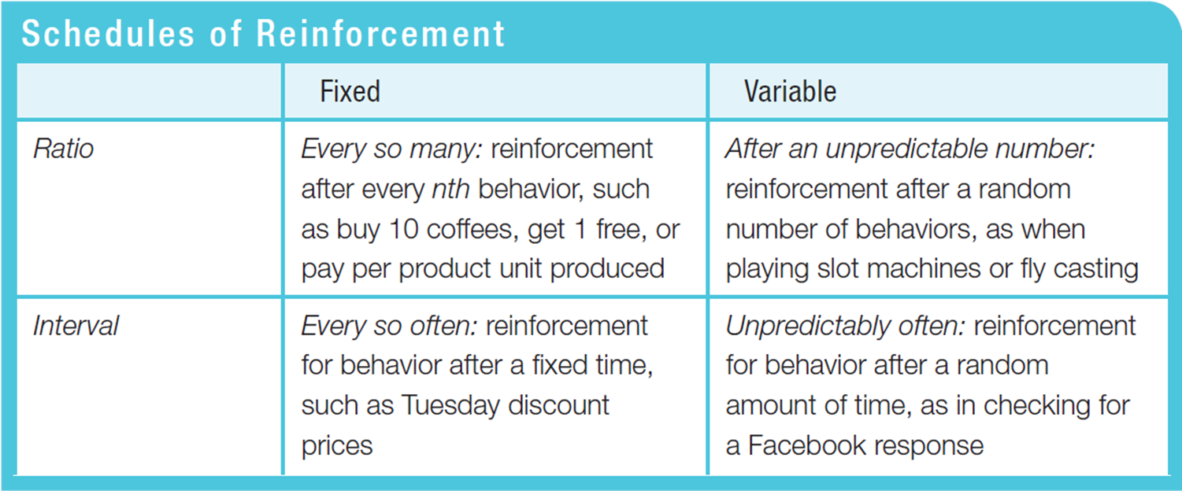
Con’d

Slide 47
Con’d
2.Punishment- refers to adding something aversive/aversive in order to decrease a behaviour
punishment involves decreasing or suppressing behavior.
Punishers can be any aversive (unpleasant) stimuli painful stimulus that weaken responses or make them unlikely to recur.
Primary punishers- pain and extreme heat or cold are inherently punishing .
secondary punishers- criticism, demerits, catcalls, scolding, fines, and bad grades.

Slide 48
Con’d
Positive punishment -adding unpleasant, aversive or painful stimulus to decrease a behavior.
Negative punishment – remove or take away a pleasant stimulus to decrease behavior
e.g. taking the student's phone or tablet because of improper use during the class.
A child fights with her brother (behavior) and has her favorite toy taken away (reinforcing stimulus removed).
eg. A child who is grounded after fighting with a sibling (positive punishment) or who loses out on the opportunity to go to recess after getting a poor grade (negative punishment) is less likely to repeat these behaviors.

Slide 49
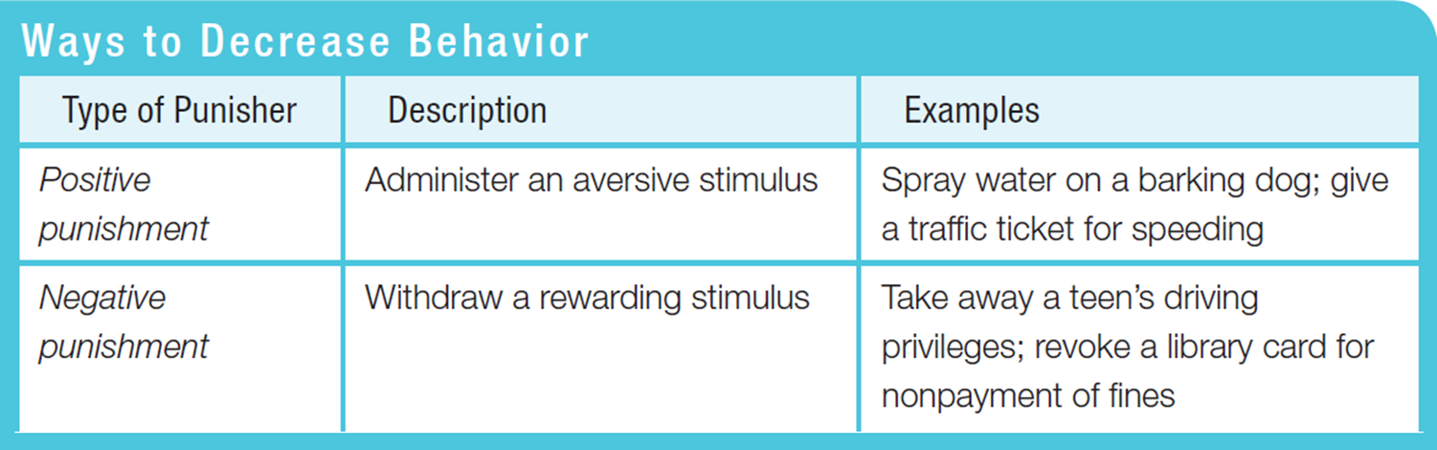
Con’d

Slide 50
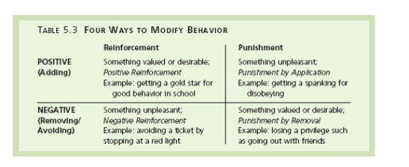
con’d

Slide 51
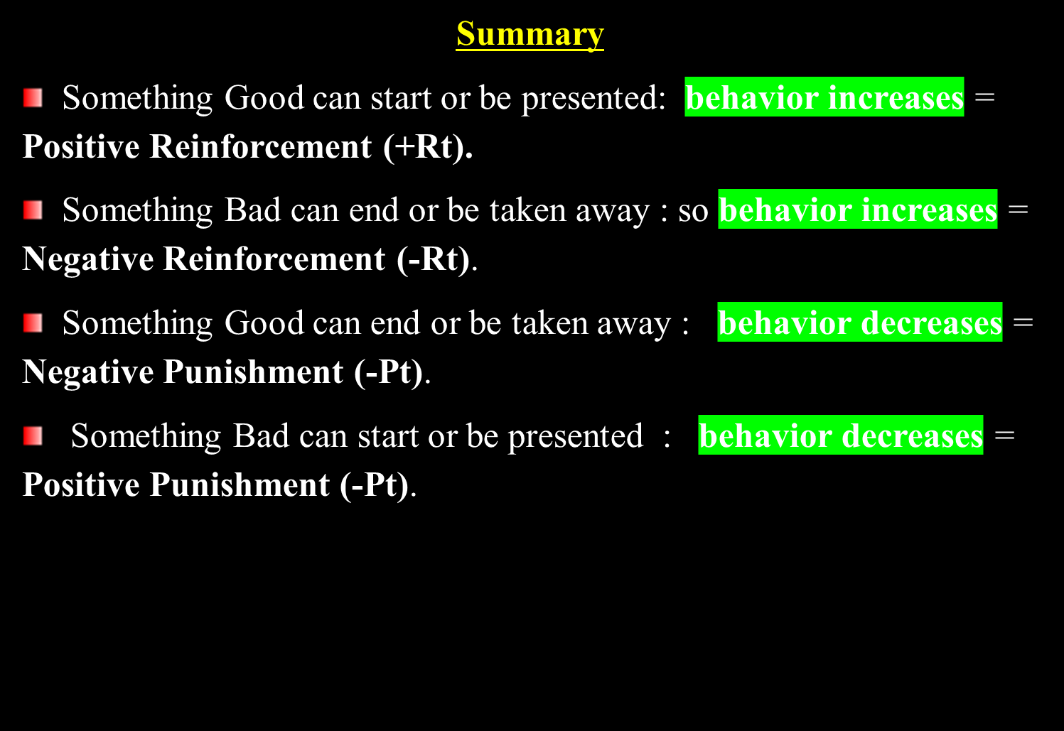
con’d

Slide 52
con’d
The Pros and Cons of Punishment
Immediacy- when punishment follows immediately after the behavior to be punished.
Consistency- when punishment is inconsistent the behavior being punished is intermittently reinforced and therefore becomes resistant to extinction.
Intensity- In general terms, severe punishments are more effective than mild ones.

Slide 53
Con’d
Making Punishment more Effective
Guidelines on how to make punishment more effective
1. Apply punishment swiftly/immediatly
A delay in delivering punishment tends to undermine its impacts. When a mother says, “wait until your father gets home…” she is making a fundamental mistake in the use of punishment.
2. Use punishment just severe enough to be Effective
The intensity of punishment is a two-edge sword.
Severe punishments usually are more effective in weakening unwanted responses.

Slide 54
Con’d
3. Make punishment consistent.
If you want to eliminate a response, you should punish the response every time it occurs.
When parents are inconsistent about punishing a particular behavior, they create more confusion than learning.
4. Explain the Punishment.
When children are punished, the reason for their punishment should be explained as fully as possible, given the constraints of this age. Punishment combined with reasoning is more effective than either alone.

Slide 55
Con’d
3.Shaping is an operant conditioning procedure in which successive approximations of a desired response are reinforced.
It involves rewarding successive approximations toward a target behaviour.
The responses that you reinforce on the way to the final one are called successive approximations.
e.g. parents use to shape to toilet train their 2 years child.

Slide 56
Con’d
Application of the theory of operant conditioning
1.Conditioning study behavior : for self-learning of a student, teacher should reinforce student behavior through variety of incentives such as prize, smile, praise, affectionate patting on the back or by giving higher marks.
2. Managing Problem Behavior: Operant conditioning is a behavior therapy technique that shape students behavior.
3. Dealing with anxieties through conditioning: through conditioning, fear, anxieties, prejudices, attitudes, and perceptual meaning develops.
Question
Compare and contrast classical and operant conditioning. How are they alike?

Slide 57
Con’d
B. Complex Learning (Cognitive Learning)
Both classical and operant conditionings have traditionally been explained by the principle of contiguity i.e. the close association of events in time and space.
Cognitive theories describe, explain and predict what occurs in the mind during such processes as thinking, remembering, problem solving, etc.
Forms of cognitive learning-cognitive Lg may take three forms.
1.Social Learning Theory (observational learning) theory- later social-cognitive approach to learning
2. Insight Learning 3. Latent Learning

Slide 58

Con’d
1.Social Learning Theory (observational learning) theory
Albert Bandura 1925-2021) the founder of this theory.

Slide 59
Con’d
Observational learning, which is learning by watching the behavior of another person’s as a model developed by Bandura often referred to as a social- cognitive approach to learning (Bandura, 1999, 2004).
According to this theory, we don’t always have to be reinforced or punished to change our behavior, but we can learn by observing, imitating, and watching the consequences of the behavior of others as a model.

Slide 60
Con’d
Bandura identifies three forms of reinforcement that can encourage observational learning.
1. the observer may reproduce the behaviors of the model and receive direct reinforcement.
2. the reinforcement need not be direct- it may be vicarious reinforcement/indirect reinforcement/ as well.
The observer may simply see others reinforced for a particular behavior and then increase his or her production of that behavior.
3.the final form of reinforcement is self-reinforcement, or controlling your reinforcers.
This sort of reinforcement is important for both students and teachers.

Slide 61
Con’d
Bandura mentions four conditions that are necessary before an individual can successfully model the behavior of someone else:
1. Attention/Acquisition: the person must first pay attention to the model.
2. Retention: the observer must be able to remember the behavior that has been observed.
One way of increasing this is using the technique of rehearsal.
3. Motor reproduction: is the ability to replicate or produce the action/ behavior that the model has just demonstrated.
This means that the observer has to be able to replicate the action.

Slide 62
Con’d
4. Motivation: the learner must motivate to produce the action.
the learners must want to demonstrate what they have learned. Remember that since these four conditions vary among individuals, different people will reproduce the same behavior differently.
Educational Implications of Social Learning Theory
1. Students often learn a great deal simply by observing other people.
2. Describing the consequences of behavior can effectively increase the appropriate behaviors and decrease inappropriate ones.
3. Modeling provides an alternative to shaping for teaching new behaviors.

Slide 63

Con’d
1. Latent learning
Edward Tolman (1948) developed a cognitive view of learning that has become popular in modern psychology.
For example, a child might learn how to complete a math problem in class, but this learning is not immediately apparent.

Slide 64
Con’d
Latent means “hidden” and thus latent learning is not immediately expressed but it occurs latter.
According to Tolman, learning can occur without reinforcement of overt actions, learning is not immediately revealed in performance but is revealed latter when reinforcement is provided for performance.
Latent learning is important because in most cases the information we have learned is not always recognizable until the moment that we need to display it.

Slide 65
Con’d
Examples- you might have learned how to cook a roast by watching your parents prepare dinner, this learning may not be apparent until you find yourself having to cook a meal on your own.
A child learns to sew by watching their mother and can easily sew when she loses a button on her own shirt.

Slide 66
Con’d
Experiment
Tolman developed the idea of latent learning and cognitive maps by placing three groups of rats in a maze every day for over two weeks.
The groups were different in the following ways:
Group 1-received rewards every time they made it through the maze.
Group 2-received no rewards when they made it through the maze.
Group 3-received no rewards for making it through the maze until day 11.
Tolman found that while Group 1, very quickly learned how to navigate the maze as a result of operant conditioning, Groups 2 and 3 only wandered aimlessly throughout the maze. However, once Group 3 received rewards on day 11, they quickly navigated the maze.

Slide 67
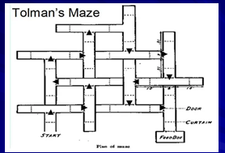
Con’d

Slide 68
Con’d
Tolman concluded that while the rats had been "wandering," they had really been creating cognitive maps- (mental representation of the reality) of the maze.
Once they knew there was reinforcement for completing the task, they demonstrated their latent learning of the maze by running it just as quickly as Group A, who had been receiving rewards all along.
In their famous experiments, Tolman and Honzik (1930) built a Maze to investigate latent learning in rats.
The study also shows that rats actively process information rather than operating on a stimulus response relationship.

Slide 69
Con’d
Note:-
Latent learning is a form of learning that is not immediately expressed in an overt response; it occurs without any obvious reinforcement of the behavior or associations that are learned.
Educational Implications of Latent Learning
The implications of latent learning for educators is that not all learning is direct.
Some learning happens without express instruction.
Children may learn skills that they only later demonstrate when they become stimulated to.

Slide 70

Con’d
Insight Learning
Learning by insight means sudden grasping of the solution, a flash of understanding, without any process of -trial-and-error.

Slide 71
Con’d
Insight learning is a type of learning or problem solving that happen all- of-a-sudden through understanding the relationship of various parts of a problem rather than though trial and error.
Is the sudden realization of a solution for a problem.
Another word related to insight learning is Epiphany- which means a movement of sudden or great realization.
Characteristics of Insight Learning
Insight leads to change in perception.
Insight is sudden.
With insight, the organism tends to perceive a pattern or organization (that helps in learning).
Understanding plays important role n insight learning.
Insight is related with higher order animals and not with inferior animals.

Slide 72
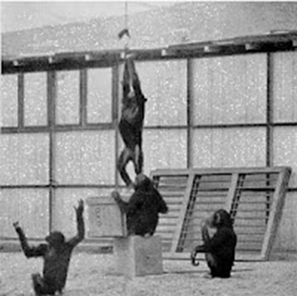
Con’d

Slide 73
Con’d
In the 1920s, German psychologist Wolfgang Kohler was introduced insight learning for the first time by studying the behavior of apes.
Gestalt psychologists developed a new theory of learning popularly known as theory of insight.
This theory is associated with the name of Kohler who conducted a series of experiments on chimpanzees.
Let us two of the classical experiments are described as follows:
Step 1
A chimpanzee named “sultan” was confined in a cage. There was a stick in the cage and outside the cage some bananas were put.

Slide 74
con’d
In the first instance on seeing the bananas chimpanzee showed restlessness and tried his best to reach the bananas but he could not reach without the help of the stick.
Step 2
In the second experiment, two sticks were used which could be fitted with each other with some mechanism.
The chimpanzee could only get the bananas with the help of both the sticks fitted in each other.
He first tried to get the bananas with the help of one stick but he failed.
All of a sudden he succeeded in fitting both the stick and could get the bananas.

Slide 75
Con’d
These and other experiment show that learning is not the result of-trial-and -error but of insight.
Insight lg is a tendency to suddenly arrive at a solution of a problem by perceiving relationships between various parts and factors involved in a situation.
Learning is therefore a synthetic activity which brings forth complete solutions of problems.
Koffka suggested that the law perception are equally applicable to learning.

Slide 76
Con’d
The four stages of insight learning
Step 1: Preparation- initially the learner feels helpless (‘I’m never going to figure this out’)
The individual gathers information about the problem (trial & error)• E.g. You are trying to program the new DVD recorder to tape shows, you try different settings, turning the TV to AV mode, etc........
Step 2: Incubation- the problem is consciously put aside.
But worked on at an unconscious level, So you go outside and shoot some hoops, because you are getting angry that you can’t solve the problem, meanwhile your brain is working on the problem

Slide 77
Con’d
Step 3: Insight -‘Aha’• ‘Aha – now I know what to do’
•Some mental event bridges the gap between the problem & the solution.
• Unconsciously the learner has reassembled the elements of the problem into a meaningful whole.
Step 4: Verification- Solution (arrived at mentally) is now tested out (physically)• This will now help with future problem solving (in a sense the learner is learning how to learn)

Slide 78
Con’d
Latent Learning: involves learning that is not immediately demonstrated or reinforced, but is stored and can be used later when necessary (e.g., observing cooking but not cooking until later).
Insight Learning: involves the sudden realization of how to solve a problem, typically through cognitive processing, with no gradual learning or trial-and-error involved (e.g., the chimpanzee figuring out how to reach the meet).
The end !

